Slide 1

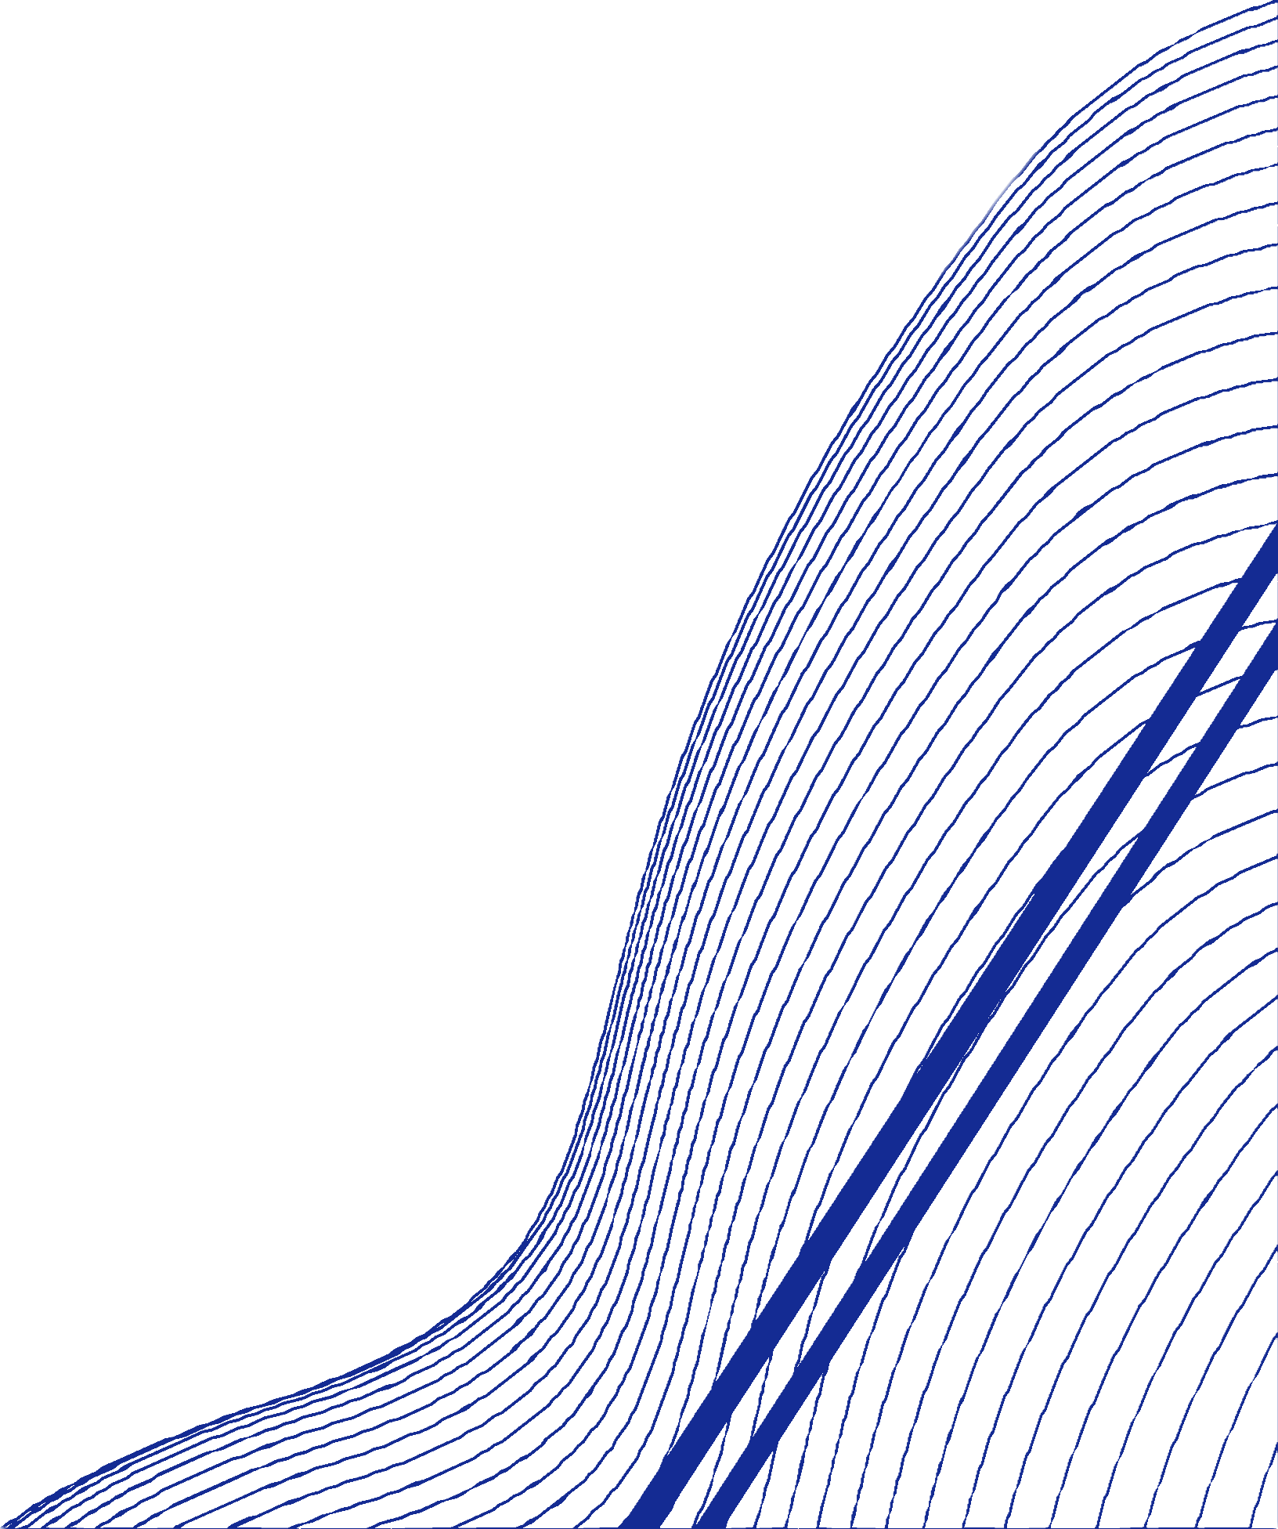


Churn Analysis for Auto Insurance
University of New Haven
Final Project Pitch Deck: GROUP 1
Distributed and Scalable Data Engineering

Slide 2

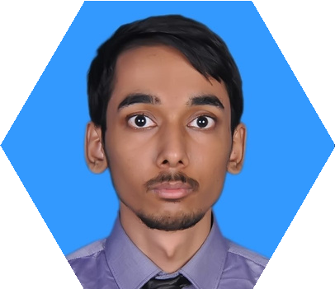
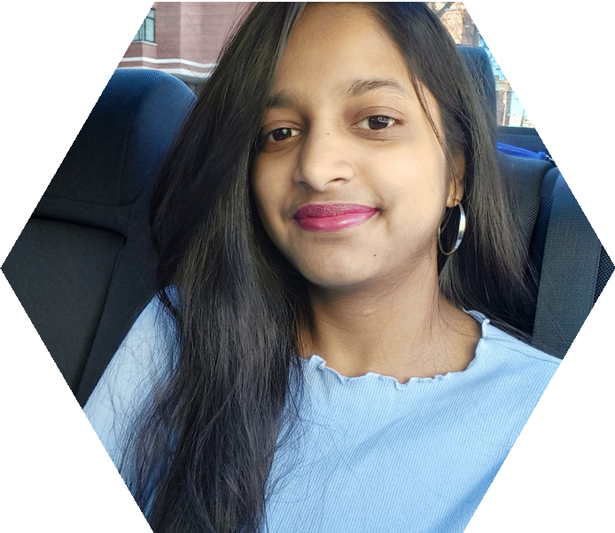
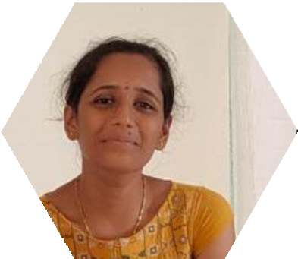

OUR TEAM
Merishna S.
ML Engineer
Bal Narendra S.
Data Analyst
Navya K.
Data Engineer
Sruthi V.
Research and Documentation

Slide 3
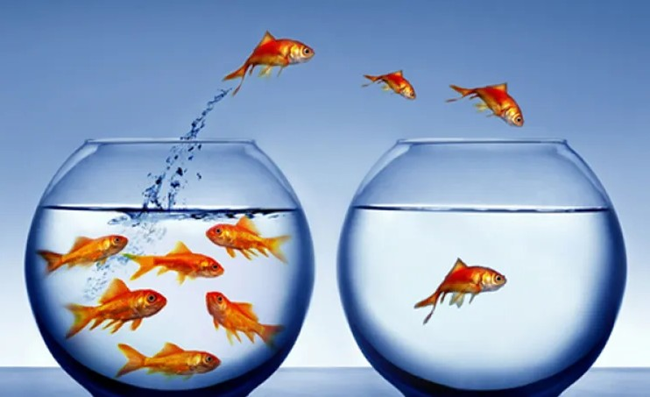

Rate at which customers stop doing business with a company over a certain period is called CHURN

Slide 4

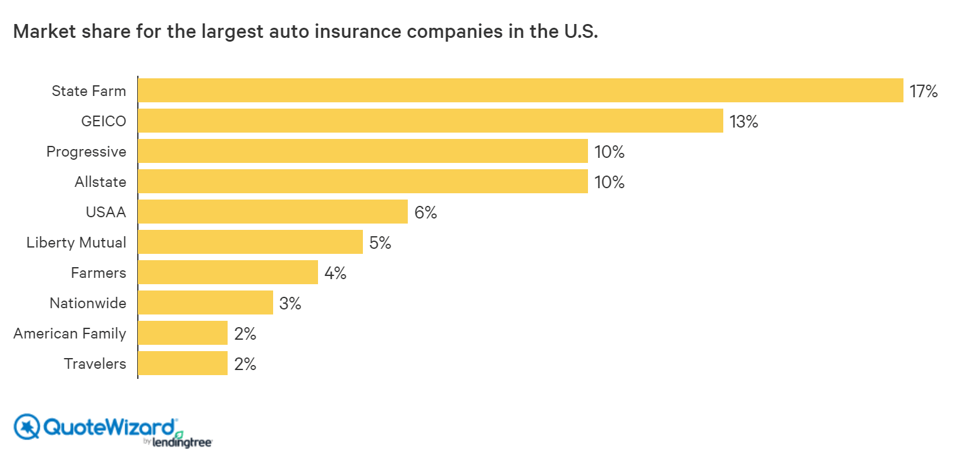

LARGEST AUTO INSURANCE COMPANIES IN THE US

Slide 5

WHY LOOK FOR A BETTER SERVICE PROVIDER?
Limited plan options
Cheaper alternatives
Poor customer service
Change in needs

Slide 6


KEY QUESTIONS
Which demographics are most likely to churn?
What factors lead to customer churn (less days of tenure)?
Are there any seasonal patterns in customer churn?
Increase customer satisfaction and loyalty

Slide 7
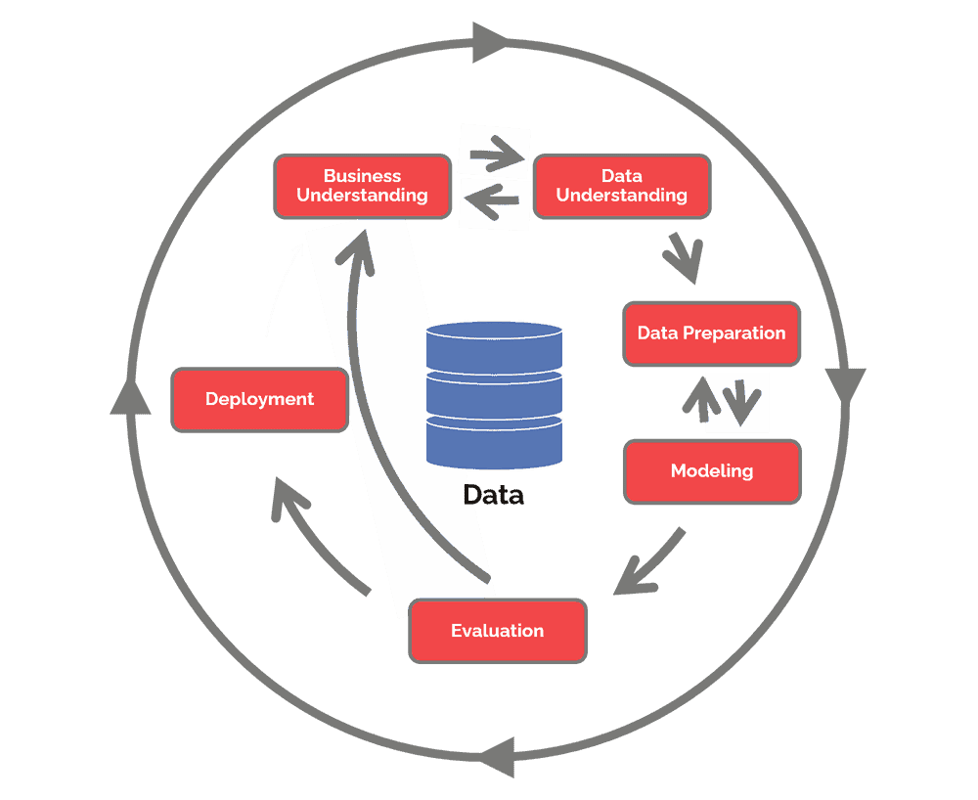
METHODOLOGY
CRISP-ML
GAIN BUSINESS UNDERSTANDING
DATA COLLECTION AND INTEGRATION DATA CLEANING AND PREPARATION DATA MODELING AND ANALYSIS

Slide 8
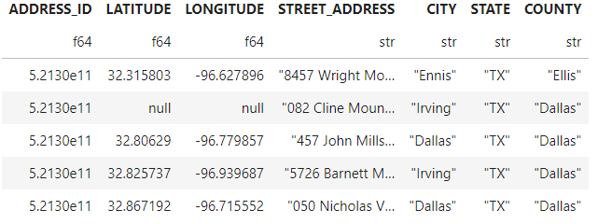
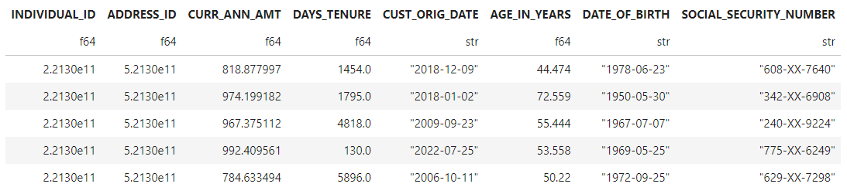
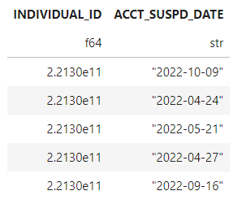
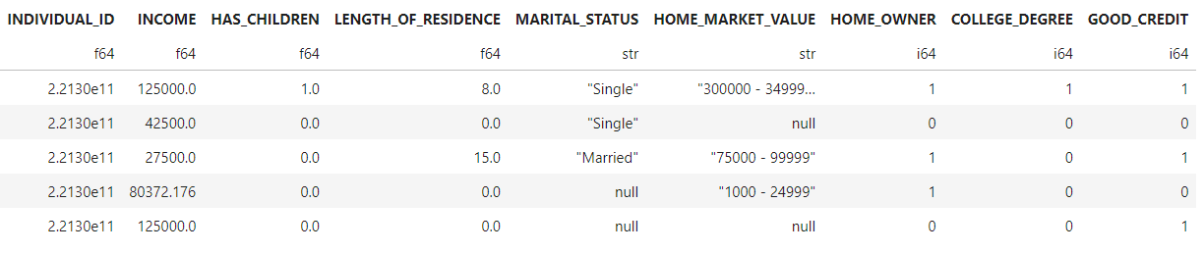

DATA CLEANING & INTEGRATION
Customers.csv
Address.csv
Demographics.csv
Termination.csv

Slide 9










WORKFLOW
Data Collection and Integration
Transform
Analysis/Modeling
(Data sources)

Slide 10
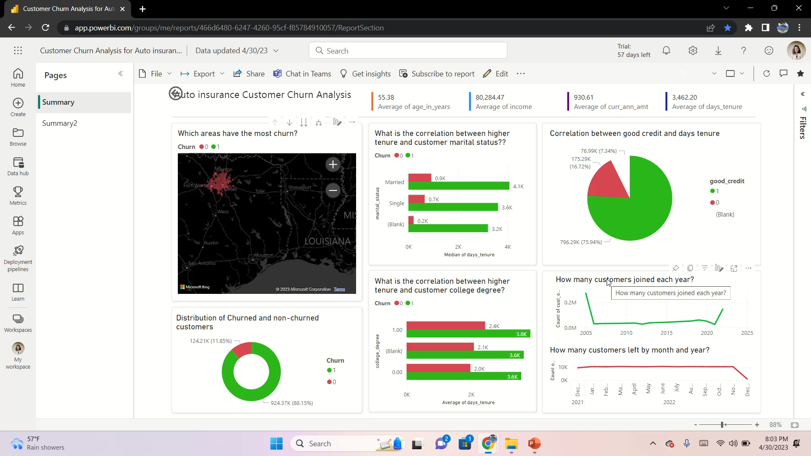

Slide 11
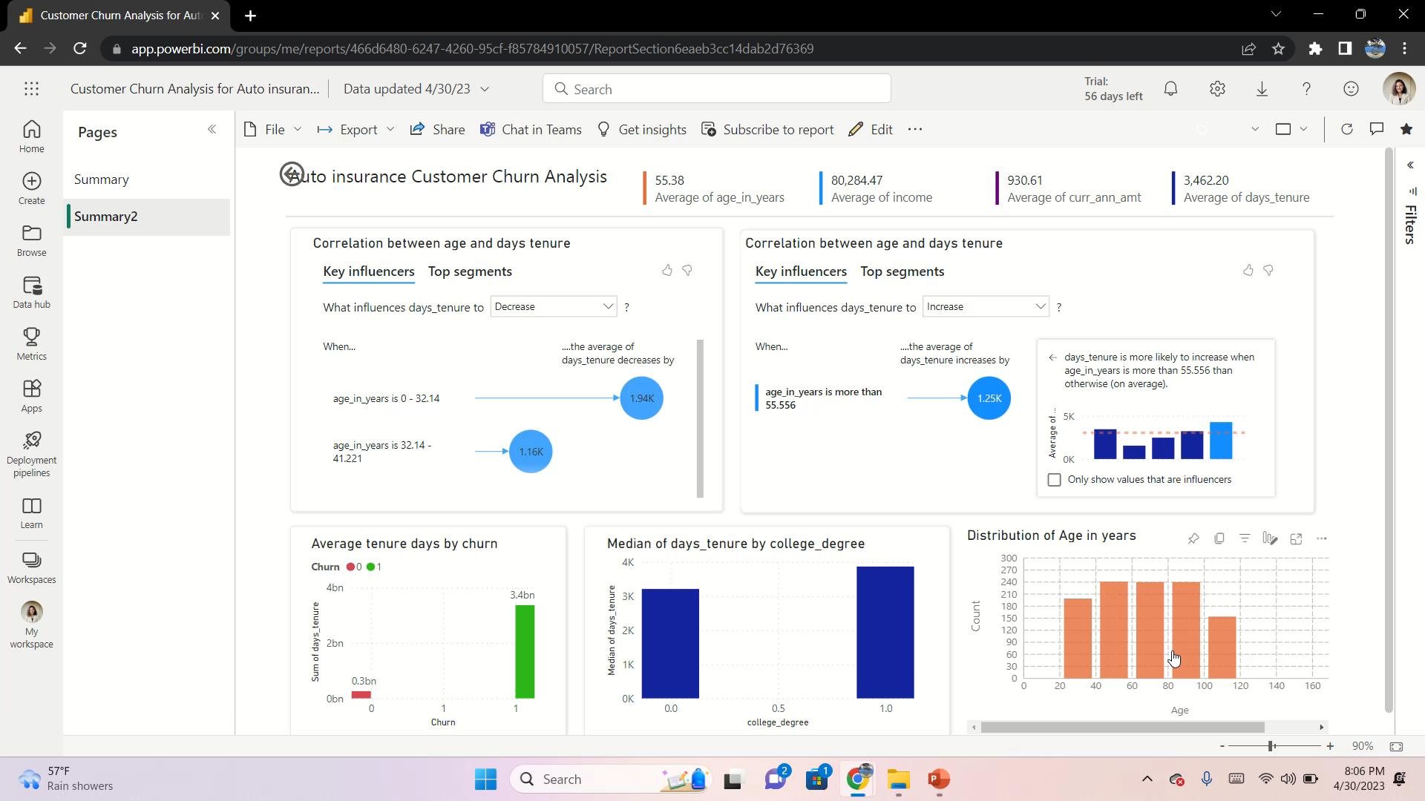

Slide 12
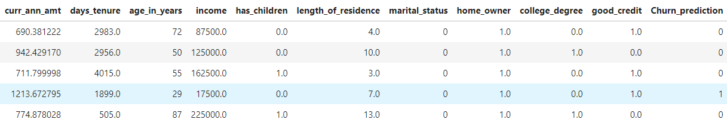
PREDICTION MODEL
Logistic Regression Model
Accuracy: 88.59%
Increase customer satisfaction and loyalty

Slide 13


THANK YOU

